Slide 1
Summer Presentation
By Charlie

Slide 2
What I learned in core
Uh… anyways

Slide 3
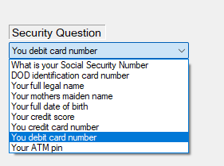
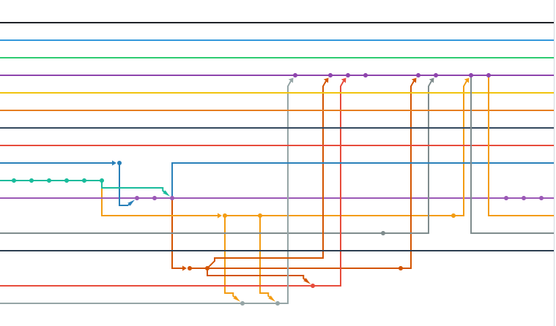
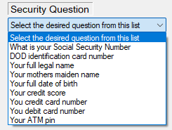
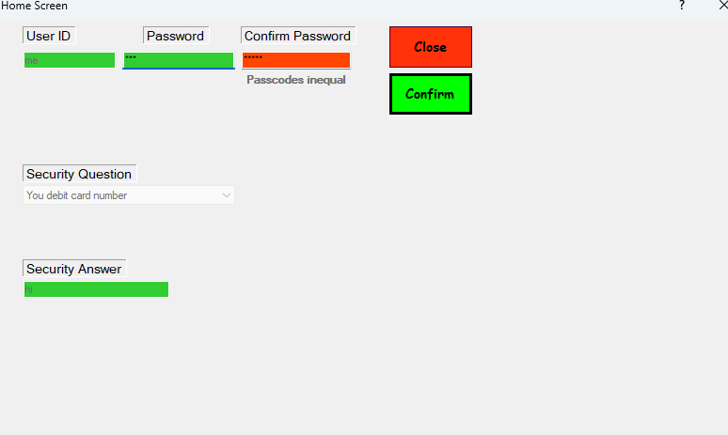
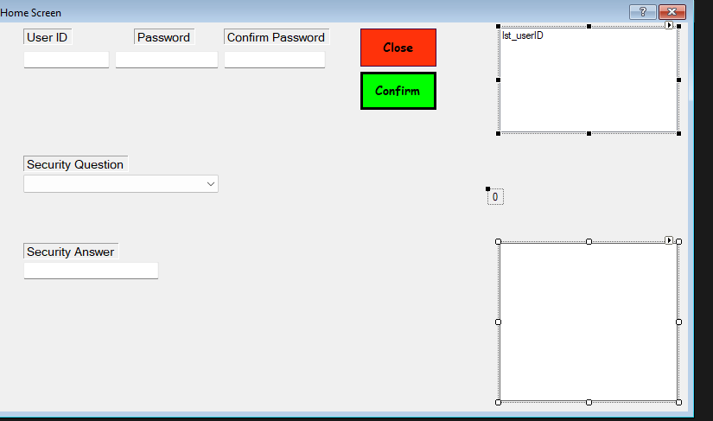
What I did in tech

Slide 4
Favorite memory
Would have to be either main event, or all the, to quote Alyssa, “mad scientist” stuff I did in app dev…

Slide 5
The End
The end
Or is it

